Slide 1

Unit 5- Computer Security
Kaizen 2006 - 2007
Security
  Four Components of Security
  Three Aspects of Security
Computer Security
  Features of Computer Security
Seven Computer Tips for Educators
MIDTERM

Slide 2
Objectives
Kaizen 2006 - 2007
Define security and computer security.
Identify the four components and three aspects of security.
Define computer security.
Determine the features of computer security.
Identify the seven computer security tips for educators
Computer Security

Slide 3
Introduction
Kaizen 2006 - 2007
Cyber security and terrorism threats are analogous:
  Real
  Serious
  Can never be eliminated, only managed
A time for prudent precaution, not irrational fear
Computer Security

Slide 4
Security
Kaizen 2006 - 2007
- is a system of safeguards for protecting information technology against disasters, systems failure, or unauthorized access that can result in damage or loss.
Computer Security

Slide 5
Four Components of Security
Kaizen 2006 - 2007
1. Identification and Access
There are three ways a computer system can verify that you have legitimate right of access. Some security systems use a mix of these techniques. The systems try to authenticate your identity by determining (1) what you have, (2) what you know, or (3) who you are.
2. Encryption
Or enciphering, is the altering of data so that it is not usable unless the changes are done.
Computer Security

Slide 6
Four Components of Security
Kaizen 2006 - 2007
3. Protection of software and data
a. Control of Access
b. Audit Controls
c. People Controls
4. Disaster-Recovery Planning
Disaster-recovery plan is a method of restoring information processing operations that have been halted by destruction or accident.
Computer Security

Slide 7
Three Aspects of Security
Kaizen 2006 - 2007
Security is the protection of assets. The three main aspects are:
prevention
detection
re-action
Computer Security

Slide 8
Some differences between traditional security and information security
Kaizen 2006 - 2007
Information can be stolen - but you still have it
Confidential information may be copied and sold - but the theft might not be detected
The criminals may be on the other side of the world
Computer Security

Slide 9
Computer Security
Kaizen 2006 - 2007
deals with the prevention and detection of unauthorised actions by users of a computer system.
Computer Security

Slide 10
What features should a computer security system provide?
Kaizen 2006 - 2007
Confidentiality
Integrity
Availability
Non-repudiation
Authentication
Access Controls
Accessibility
Computer Security

Slide 11
Confidentiality
Kaizen 2006 - 2007
The prevention of unauthorised disclosure of information.
Confidentiality is keeping information secret or private.
Confidentiality might be important for military, business or personal reasons.
Computer Security

Slide 12
Integrity
Kaizen 2006 - 2007
Integrity is the unauthorised writing or modification of information.
Integrity means that there is an external consistency in the system - everything is as it is expected to be.
Data integrity means that the data stored on a computer is the same as the source documents.
Computer Security

Slide 13
Availability
Kaizen 2006 - 2007
Information should be accessible and usable upon appropriate demand by an authorised user.
Availability is the prevention of unauthorised withholding of information.
Denial of service attacks are a common form of attack.
Computer Security

Slide 14
Non-repudiation
Kaizen 2006 - 2007
Non-repudiation is the prevention of either the sender or the receiver denying a transmitted message.
A system must be able to prove that certain messages were sent and received.
Non-repudiation is often implemented by using digital signatures.
Computer Security

Slide 15
Authentication
Kaizen 2006 - 2007
Proving that you are who you say you are, where you say you are, at the time you say it is.
Authentication may be obtained by the provision of a password or a scan of your retina.
Computer Security

Slide 16
Access Controls
Kaizen 2006 - 2007
The limitation and control of access through identification and authentication.
A system needs to be able to indentify and authenticate users for access to data, applications and hardware.
In a large system there may be a complex structure determining which users and applications have access to which objects.
Computer Security

Slide 17
Accountability
Kaizen 2006 - 2007
The system managers are accountable to scrutiny from outside.
Audit trails must be selectively kept and protected so that actions affecting security can be traced back to the responsible party
Computer Security

Slide 18
Security systems
Kaizen 2006 - 2007
A security system is not just a computer package. It also requires security conscious personnel who respect the procedures and their role in the system.
Conversely, a good security system should not rely on personnel having security expertise.
Computer Security

Slide 19
Risk Analysis
Kaizen 2006 - 2007
The disadvantages of a security system are that they are time-consuming, costly, often clumsy, and impede management and smooth running of the organisation.
Risk analysis is the study of the cost of a particular system against the benefits of the system.
Computer Security

Slide 20
Designing a Security System
Kaizen 2006 - 2007
There are a number of design considerations:
Does the system focus on the data, operations or the users of the system?
What level should the security system operate from? Should it be at the level of hardware, operating system or applications package?
Should it be simple or sophisticated?
In a distributed system, should the security be centralised or spread?
How do you secure the levels below the level of the security system?
Computer Security

Slide 21
Security Models
Kaizen 2006 - 2007
A security model is a means for formally expressing the rules of the security policy in an abstract detached way.
The model should be:
easy to comprehend
without ambiguities
possible to implement
a reflection of the policies of the organisation.
Computer Security

Slide 22
Seven Computer Security Tips for Educators
Kaizen 2006 - 2007
2005 Global Studies Summer Institute
University of Wisconsin – Milwaukee
Robert J. Beck, Ph.D.
Computer Security

Slide 23
Introduction
Kaizen 2006 - 2007
The Principal Threats
How to Respond: 7 Tips
Computer Security

Slide 24
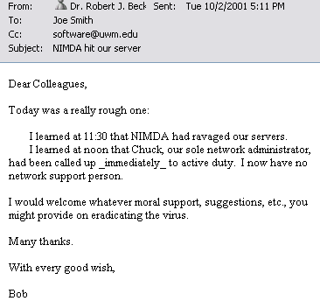
Virus/Security Impact at UWM
Kaizen 2006 - 2007
Nimda hits CIE – October 2, 2001
Computer Security

Slide 25
Virus/Security Impact at UWM
Kaizen 2006 - 2007
Virus/Security-Related Help Request Hours: UWM Help Desk
  2002 - 485 hours
  2003 - 683 hours
  2004 - 1,037 hours
Computer Security

Slide 26
The Principal Threats
Kaizen 2006 - 2007
Hacking
Computer Viruses
Spam
Phishing
Spyware
Computer Security

Slide 27
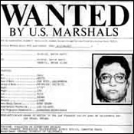
Hacking
Kaizen 2006 - 2007
“Illegally accessing other people's computer systems for destroying, disrupting or carrying out illegal activities on the network or computer systems”
Computer Security

Slide 28
Hacking: Examples
Kaizen 2006 - 2007
Computer “Worm”
“Trojan Horse”
“Logic Bomb”
Computer Security

Slide 29
Computer Worm
Kaizen 2006 - 2007
A self-replicating computer program, similar to a computer virus
Unlike a virus, it is self-contained and does not need to be part of another program to propagate itself
Often designed to exploit computers’ file transmission capabilities
Computer Security

Slide 30

Computer Worm
Kaizen 2006 - 2007
The name “worm” was taken from The Shockwave Rider, a 1970’s science fiction novel by John Brunner.
Researchers writing an early paper on experiments in distributed computing noted the similarities between their software and the program described by Brunner and adopted the name.
Computer Security

Slide 31
Computer Worm
Kaizen 2006 - 2007
The first implementation of a worm was by two researchers at Xerox PARC in 1978
The first worm to attract wide attention was released on November 2, 1988: the Morris worm, written by a Cornell graduate student
Computer Security

Slide 32
Computer Worm
Kaizen 2006 - 2007
In addition to replication, a worm may be designed to:
  delete files on a host system
  send documents via email
  carry other executables as a payload
Computer Security

Slide 33
Trojan Horse
Kaizen 2006 - 2007
A malicious program disguised as legitimate software
Cannot replicate itself, in contrast to some other types of “malware” like worms and viruses
Computer Security

Slide 34
Trojan Horse
Kaizen 2006 - 2007
Can be
  Deliberately attached to otherwise useful software by a programmer, or
  Spread by tricking users into believing that it is a useful program
Computer Security

Slide 35

Trojan Horse
Kaizen 2006 - 2007
Contains
  Spying functions (such as a “Packet sniffer”) or
  “Backdoor” functions that allow a computer to be remotely controlled from the network
Can be used to set up networks of zombie computers in order to launch “DDoS” attacks or send spam
Computer Security

Slide 36

Logic Bomb
Kaizen 2006 - 2007
“Slag code”
Programming code, inserted surreptitiously, designed to execute (or “explode”) under particular circumstances
Computer Security

Slide 37
Logic Bomb
Kaizen 2006 - 2007
Does not replicate
Essentially a delayed-action computer virus or Trojan horse
Computer Security

Slide 38
Computer Viruses
Kaizen 2006 - 2007
“Software programs capable of reproducing themselves and usually capable of causing great harm to files or other programs on the same computer”
a true virus cannot spread to another computer without human assistance
Computer Security

Slide 39
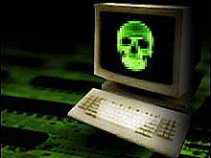
Computer Viruses
Kaizen 2006 - 2007
Clog networks by propagating themselves
Impose great costs in cleanup and downtime for network and desktop users
Computer Security

Slide 40
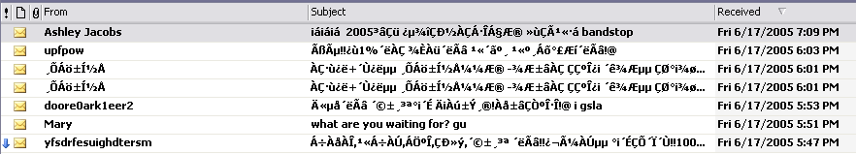
Spam
Kaizen 2006 - 2007
“Unsolicited commercial e-mail”
Computer Security

Slide 41
Phishing
Kaizen 2006 - 2007
“a type of deception designed to steal your identity”
In phishing scams, scam artists try to get you to disclose valuable personal data—like credit card numbers, passwords, account data, or other information—by convincing you to provide it under false pretenses.
Phishing schemes can be carried out in person or over the phone, and are delivered online through spam e-mail or pop-up windows.
Computer Security

Slide 42
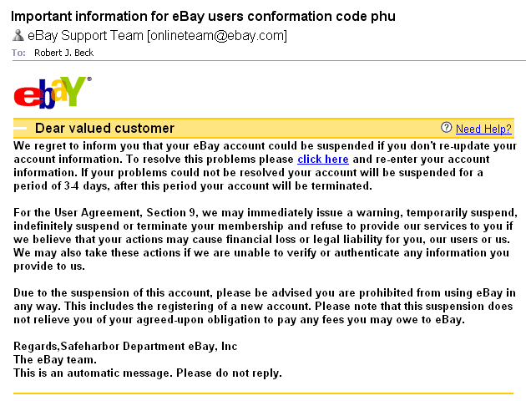
Phishing
Kaizen 2006 - 2007
Computer Security

Slide 43

Phishing
Kaizen 2006 - 2007
In May 2005, the number of unique phishing attacks reported to the Anti-Phishing Working Group: 1,197
an average of 38.6 reports each day
Computer Security

Slide 44

Spyware
Kaizen 2006 - 2007
“Computer software that gathers and reports information about a computer user without the user's knowledge or consent.”
Computer Security

Slide 45
Spyware
Kaizen 2006 - 2007
These products perform many different functions, including:
  the delivery of unsolicited advertising (pop-up ads in particular)
  harvesting private information
  re-routing page requests to allow fraudulent claims of commercial-site-referral fees, and
  installing stealth phone dialers.
Computer Security

Slide 46
Spyware
Kaizen 2006 - 2007
Spyware lurks on as many as 80% of computers nationwide, according to the National Cyber Security Alliance, a trade group.
In a recent survey, 31% of online shoppers said they were buying less than before because of security issues.
Computer Security

Slide 47
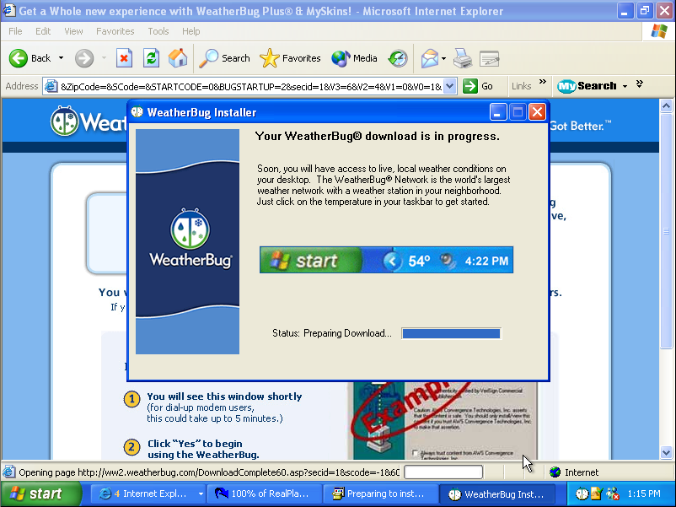

Slide 48
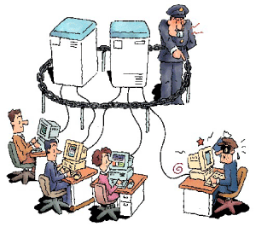
Seven Tips
Kaizen 2006 - 2007
Computer Security

Slide 49
1. Perform Basic Computer Safety Maintenance
Kaizen 2006 - 2007
Use an Internet “firewall”
Update your computer
Use up-to-date antivirus software
Computer Security

Slide 50
A. Use an Internet Firewall
Kaizen 2006 - 2007
A firewall is software or hardware that creates a protective barrier between your computer and potentially damaging content on the Internet or network.
The firewall helps to guard your computer against malicious users, and also against malicious software such as computer viruses and worms.
Computer Security

Slide 51
A. Use an Internet Firewall
Kaizen 2006 - 2007
Microsoft Windows XP helps to provide more security in the form of a firewall that is known as the Internet Connection Firewall (ICF).
Windows XP Service Pack 2 (SP2) includes the new Windows Firewall, which replaces the ICF.
Computer Security

Slide 52
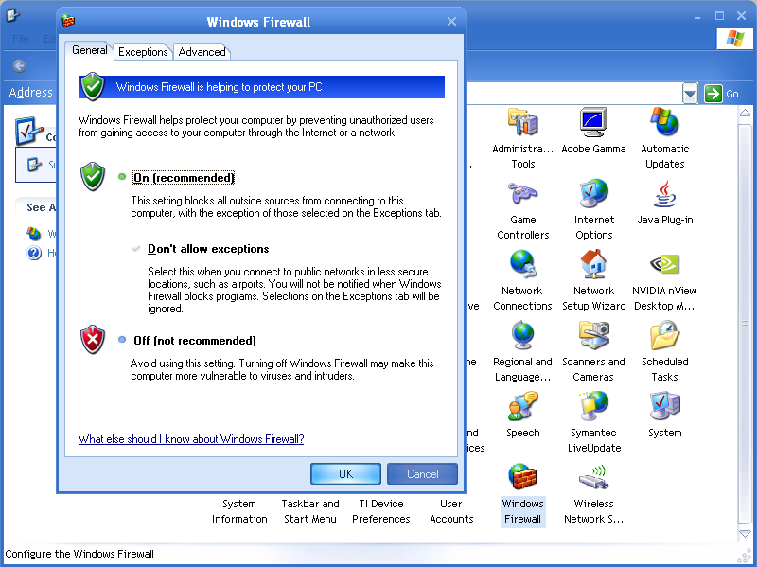

Slide 53
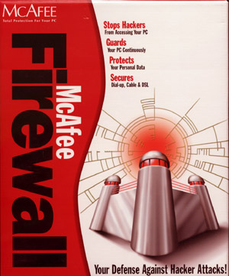
A. Use an Internet Firewall
Kaizen 2006 - 2007
Commercial hardware and software firewalls may also be used
Computer Security

Slide 54
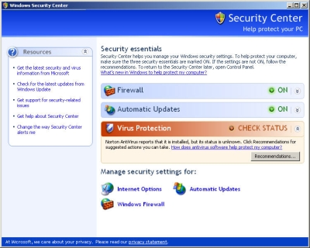
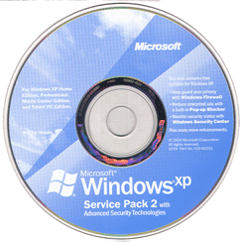
B. “Update” Your Computer
Kaizen 2006 - 2007
Download service packs and updates
Especially important for Windows XP users: “SP2”
Computer Security

Slide 55
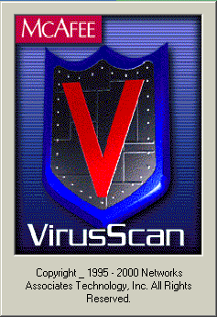
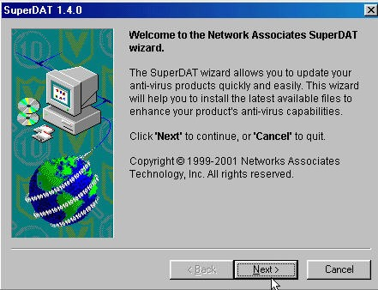
C. Use Up-to-date Antivirus Software
Kaizen 2006 - 2007
McAfee and Symantec are prominent vendors
Make certain to keep “virus definitions” up-to-date
Computer Security

Slide 56
Kaizen 2006 - 2007
Antivirus Software
CAN | CANNOT
Before infection, detect viruses | Recover files deleted by a virus
Clean valid data files infected with a virus | Restore system files modified, damaged, or deleted by a virus
Detect delayed payload viruses on your hard drive or floppies | Remove some system and boot record infectors
Computer Security

Slide 57
2. Don't Open Files from Strangers
Kaizen 2006 - 2007
E-mail and instant messaging (IM) can spread viruses and worms if you aren't careful.
Most e-mail viruses are spread by people who are fooled into opening an infected file
Don’t be tricked! You should never open a file attached to an e-mail or an instant message unless you recognize the sender and you are expecting the file.
Computer Security

Slide 58
Related Resource in GSSI Binder
Kaizen 2006 - 2007
10 Tips for Safer Instant Messaging
Computer Security

Slide 59
3. Help Fight Spam and Online Scams
Kaizen 2006 - 2007
Get spam filters to suit you
Block unwanted instant messages (IM)
Block images
Keep your spam filters current
Be careful about sharing your e-mail or instant message address
Improve your computer’s security
Be wary of “phishing”
Computer Security

Slide 60
Related Resources in GSSI Binder
Kaizen 2006 - 2007
5 Tips for Protecting Your E-mail and Instant Message Addresses
4 Spam Do’s and 6 Don'ts
Help Prevent Identity Theft from Phishing Scams
Computer Security

Slide 61
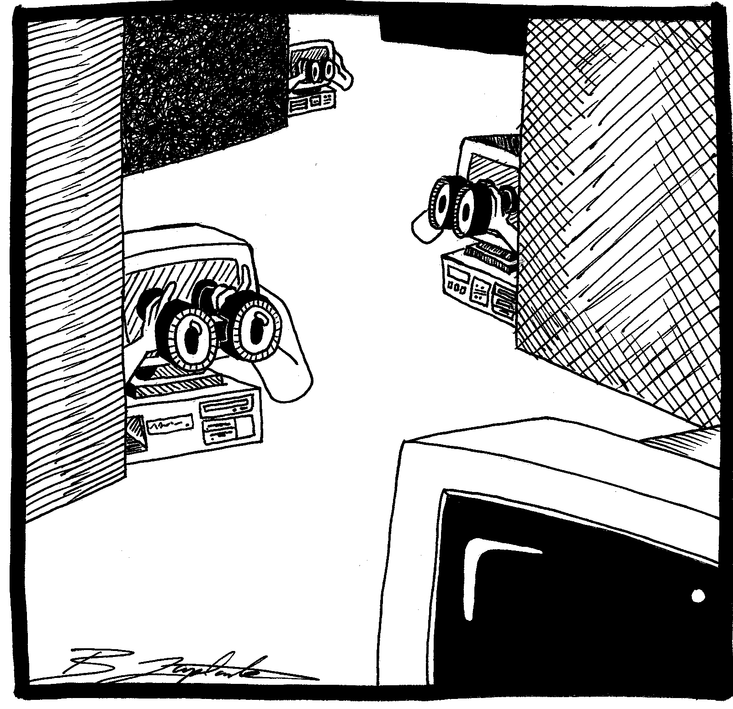
4. Learn How to Protect Yourself from Spyware
Kaizen 2006 - 2007
Spyware is software that collects personal information from you without first letting you know what it's doing, and without asking for your permission.
Computer Security

Slide 62
4. Learn How to Protect Yourself from Spyware
Kaizen 2006 - 2007
You might get spyware if you download:
  music or file-sharing programs
  free games from sites you don’t trust, or
  other software programs from a suspicious Web site.
Computer Security

Slide 63
4. Learn How to Protect Yourself from Spyware: Signs
Kaizen 2006 - 2007
I see pop-up advertisements all the time.
My settings have changed and I can’t change them back to the way they were.
My Web browser contains additional components that I don't remember downloading.
My computer seems sluggish.
Computer Security

Slide 64
4. Learn How to Protect Yourself from Spyware
Kaizen 2006 - 2007
In addition to performing basic maintenance:
  Use Mozilla Firefox browser and/or adjust Internet Explorer security settings
  Surf and download more safely
  Download and install anti-spyware protection
Computer Security

Slide 65
Anti-Spyware Protection
Kaizen 2006 - 2007
Free
  Spybot Search & Destroy
  Ad-Aware
  Microsoft Windows AntiSpyware (Beta)
Commercial
  Pest Patrol
  Webroot Spy Sweeper
Computer Security

Slide 66
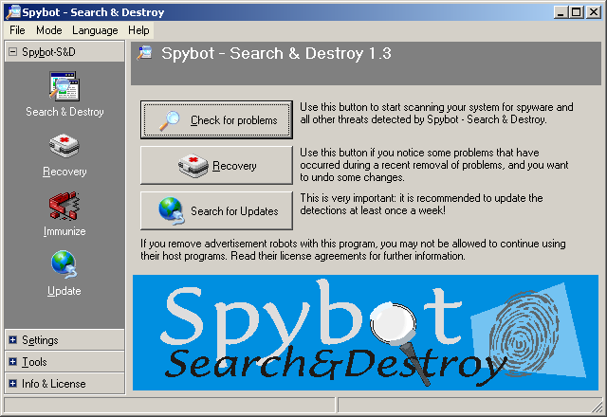
Kaizen 2006 - 2007
UNIT TITLE

Slide 67
5. Take Precautions When You Go Wireless
Kaizen 2006 - 2007
Many high school and college campuses now have “wireless networks.”
These afford Web connectivity in the library, cafeteria, or a classroom.
While convenient, they entail security risks.
Computer Security

Slide 68
5. Take Precautions When You Go Wireless
Kaizen 2006 - 2007
In addition to securing your computer (e.g., updates, firewall), secure your network:
  Using a broadband router to share your Internet connection
  Enabling “Wired Equivalent Privacy” (WEP) on your wireless network
Computer Security

Slide 69
6. Password Protect Your Computer—and Lock It
Kaizen 2006 - 2007
Passwords are the first line of defense in protecting your computer from criminals, pranksters, or a careless roommate.
If you don't use a password to log on to your computer, anyone can access your computer and unlock it.
Computer Security

Slide 70
6. Password Protect Your Computer—and Lock It
Kaizen 2006 - 2007
“Strong passwords” DO feature:
  A Minimum of 8 characters
  Upper and lower case
  Some non-letter characters like %, # and *
Computer Security

Slide 71
6. Password Protect Your Computer—and Lock It
Kaizen 2006 - 2007
“Strong passwords” DO NOT feature:
  Any combination of consecutive numbers or letters such as "12345678", "lmnopqrs", or adjacent letters on your keyboard such as "qwerty"
  Your login name, your spouse's name, or your birthday
  Any word that can be found in the dictionary
Computer Security

Slide 72
6. Password Protect Your Computer—and Lock It
Kaizen 2006 - 2007
The easiest way to create a strong password that you won't have to write down is to come up with a “passphrase.”
A passphrase is a sentence that you can remember
Computer Security

Slide 73
6. Password Protect Your Computer—and Lock It
Kaizen 2006 - 2007
"My son Aiden is three years older than my daughter Anna."
  Msaityotmda OR
  M$8ni3y0tmd@
Computer Security

Slide 74
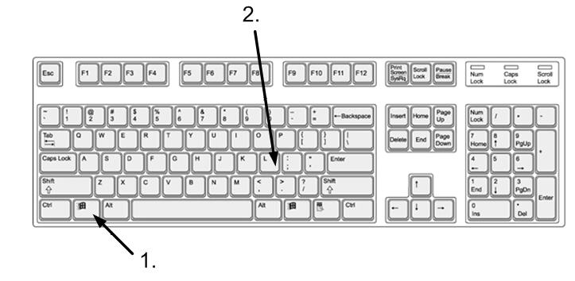
6. Password Protect Your Computer—and Lock It
Kaizen 2006 - 2007
To “lock” your Windows computer, hold down “Windows logo key + L.”
Computer Security

Slide 75
7. Back Up Your Work
Kaizen 2006 - 2007
Don’t exclude personal/fun materials from your back-ups
Tools
  Windows XP” Windows Backup utility “Ntbackup.exe”
  Microsoft Outlook: “Personal Folders Backup Utility”
  Norton Ghost 9
  Nero 6: Back-up
Computer Security

Slide 76
Review
Kaizen 2006 - 2007
Perform basic computer safety maintenance
Don't open files from strangers
Help fight spam and online scams
Learn how to protect yourself from spyware
Take precautions when you go wireless
Password protect your computer—and lock it
Back up your work
Computer Security

Slide 77
Summary
Kaizen 2006 - 2007
By now you should have some idea about
Why we need computer security (prevention, detection and re-action)
What a computer security system does (confidentiality, integrity, availability, non-repudiation, authentication, access control, accountability)
What computer security exerts do (design, implement and evaluate security systems)
Computer Security

Slide 78
Evaluation
Kaizen 2006 - 2007
Security is _________.
Computer Security is ______.
What is the importance of computer security?
What is Biometrics?
Computer Security

